Slide 1
Graphs

Slide 2
What is a graph?
A data structure that consists of a set of nodes (vertices) and a set of edges (arcs, link) that connect the nodes to each other
The set of edges describes relationships among the vertices
Formal definition of graphs
A graph G is defined as follows:
G=(V,E)
V(G): a finite, nonempty set of vertices {v₁, v₂, …, v_{n}}
E(G): a set of edges {e₁, e₂, …, e_{m}} where each e_{i} connects two
vertices (v_{i1}, v_{i2})
|E| =< |V|²

Slide 3
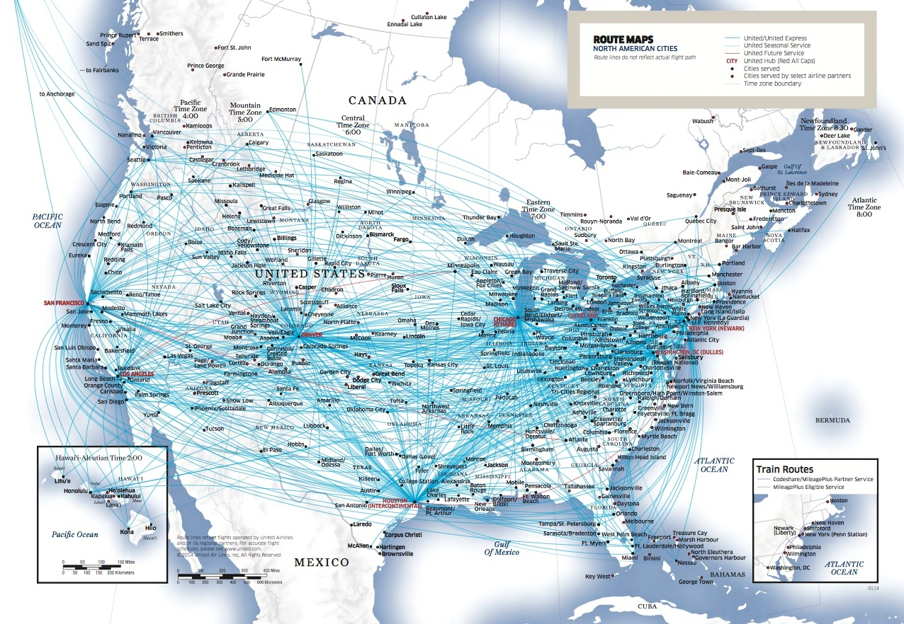
Airline routes
What is the best flight from one city to another?
Total Number of Airports by Country http://chartsbin.com/view/1395

Slide 4

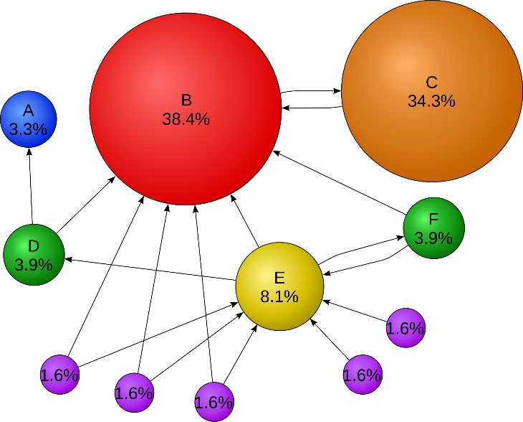
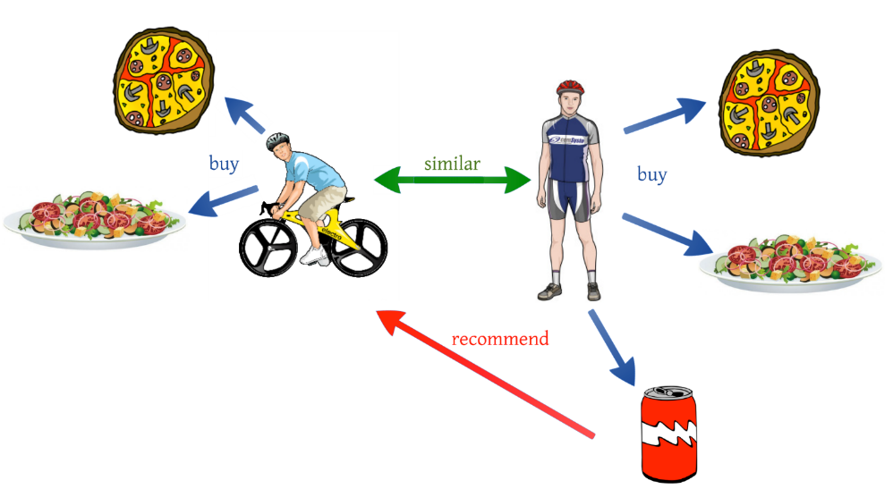
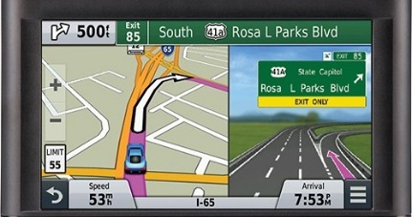
Social networks (e.g., facebook)
Google’s PageRank: number and quality of a page determine the importance of a website https://en.wikipedia.org/wiki/PageRank
Recommendation systems (e.g., Amazon)
Maps and driving directions. What is the shortest route?

Slide 5
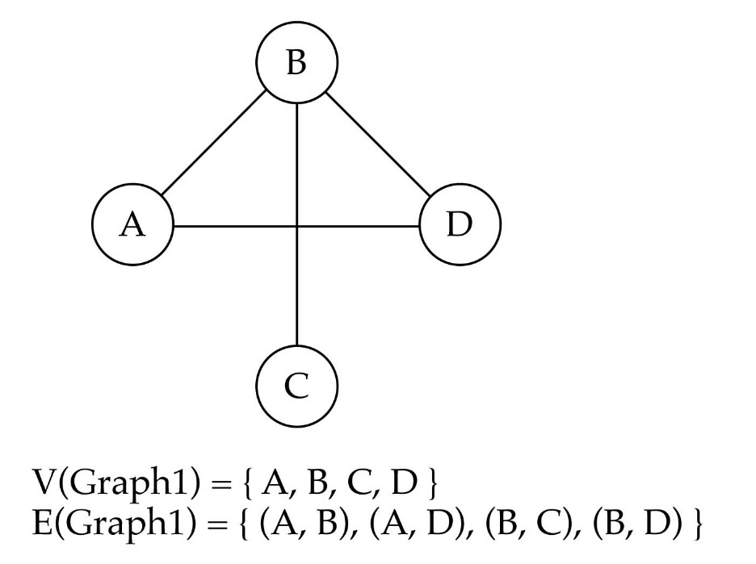
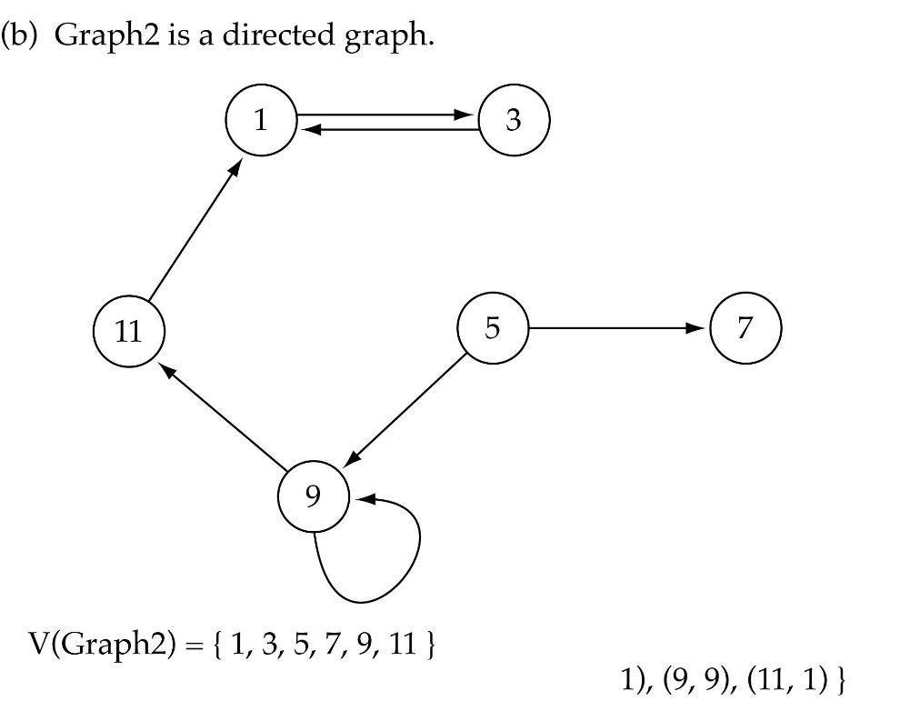
Directed vs. undirected graphs
When the edges in a graph have no direction, the graph is called undirected (e.g., flight network)
When the edges in a graph have a direction, the graph is called directed (or digraph) (e.g., route network)
E(Graph2) = {(1,3) (3,1) (5,9) (9,11) (5,7)
If the graph is directed, the order of the vertices in each edge is important.

Slide 6
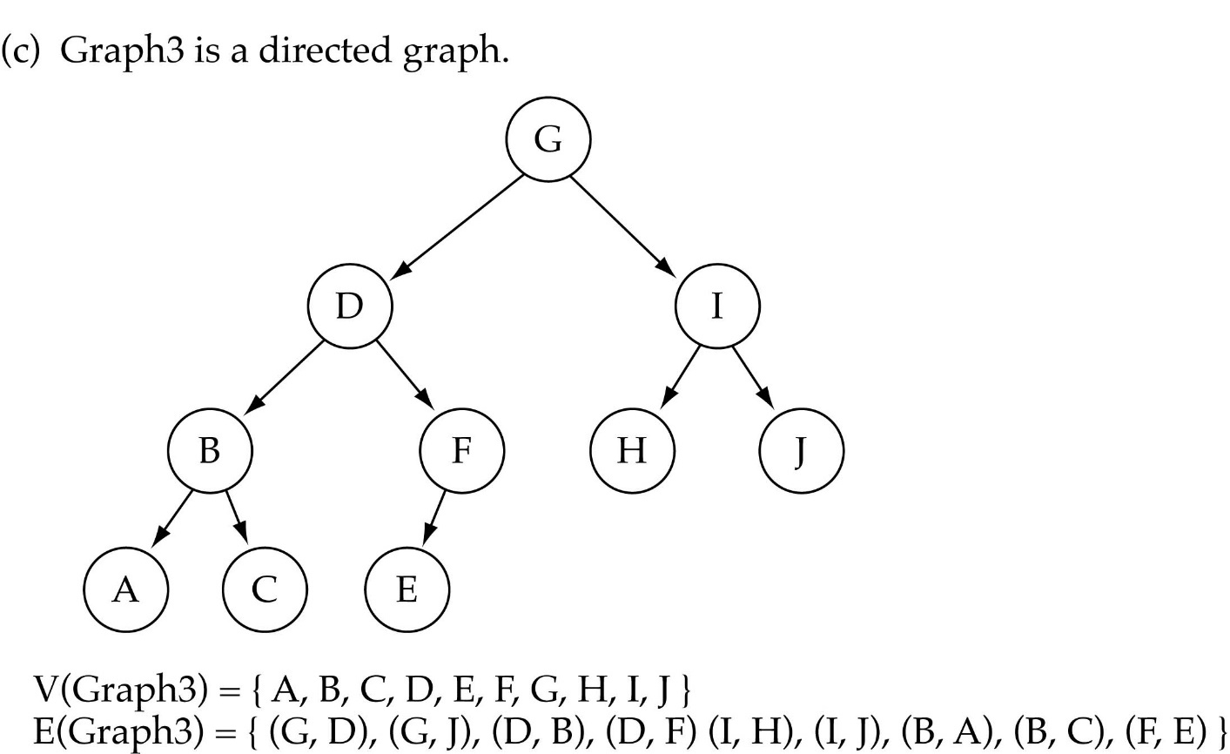
Trees vs graphs
Every tree is a graph with some restrictions:
the tree is directed
there are no cycles (directed or undirected)
there is a directed path from the root to every node

Slide 7
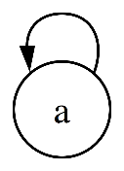
Graph terminology
A subgraph consists of a subset of a graph’s vertices and a subset of its edges
Adjacent nodes: two nodes are adjacent if they are connected by an edge
Path: a sequence of vertices that connect two nodes in a graph
Path length: number of edges on a path, which is equal to the number of vertices - 1.
Simple path: a path where all of the vertices are distinct.
Loop (self-loop) is an edge that connects a vertex to itself.
Cycle: a path that begins and ends at same vertex and its length is at least 1 (e.g., {A, D, E, B, A} )
Simple cycle: cycle that does not pass through other vertices more than once

Slide 8
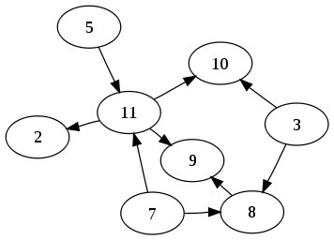
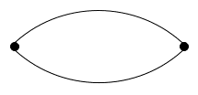
Directed Acyclic Graph (DAG): directed graphs with no cycles.
Multiple edges (parallel edges or a multi-edge) are two or more edges that are incident to the same two vertices (e.g., multiple flights between 2 cities).

Slide 9
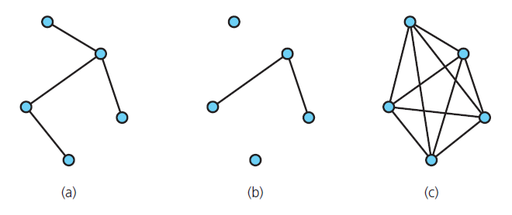
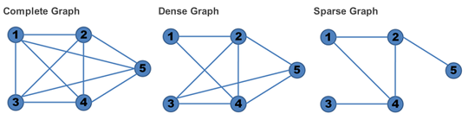
Connected graph: each pair of distinct vertices has a path between them
Complete graph: each pair of distinct vertices has an edge between them
A graph that is (a) connected (b) disconnected and (c) complete
Dense graph: number of edges is close to the maximal number of edges.
Sparse graph number of edges is close to the minimal number of edges.

Slide 10
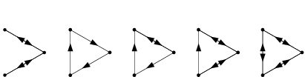
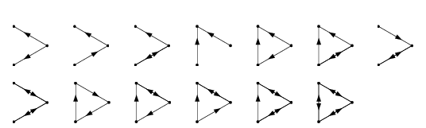
Degree of a node: The number of edges it has
The in-degree of a node is the number of in-edges it has
The out-degree of a node is the number of out-edges it has
A digraph is said to be strongly connected if there is a path between any two vertices in both directions. The nodes in a strongly connected digraph therefore must all have indegree of at least 1.
A digraph is said to be weakly connected if there is a path between any two vertices, ignoring direction. The nodes in a weakly connected digraph therefore must all have either outdegree or indegree of at least 1.

Slide 11
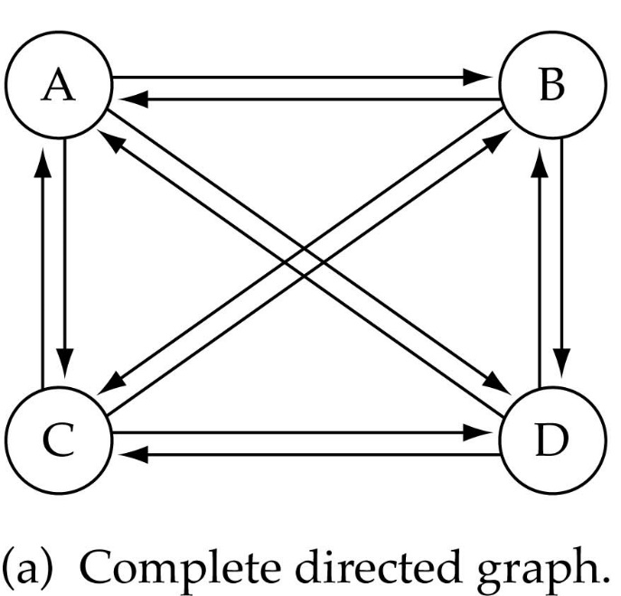
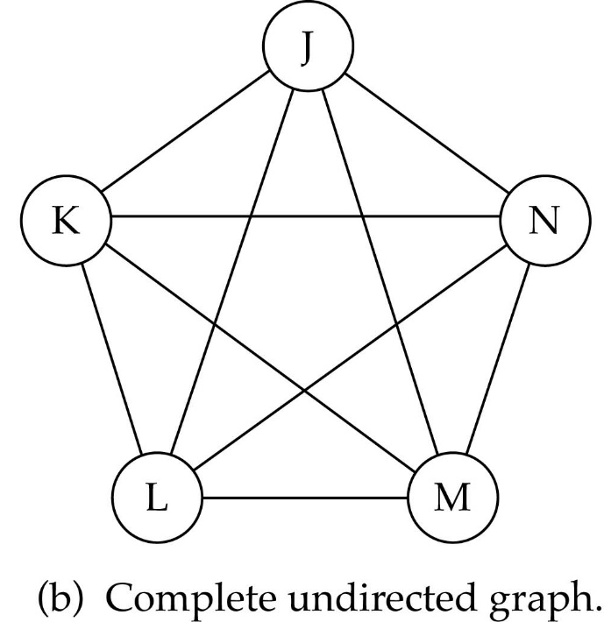
What is the number of edges in a complete directed graph with N vertices?
What is the number of edges in a complete undirected graph with N vertices?
N * (N-1)
N * (N-1) / 2

Slide 12
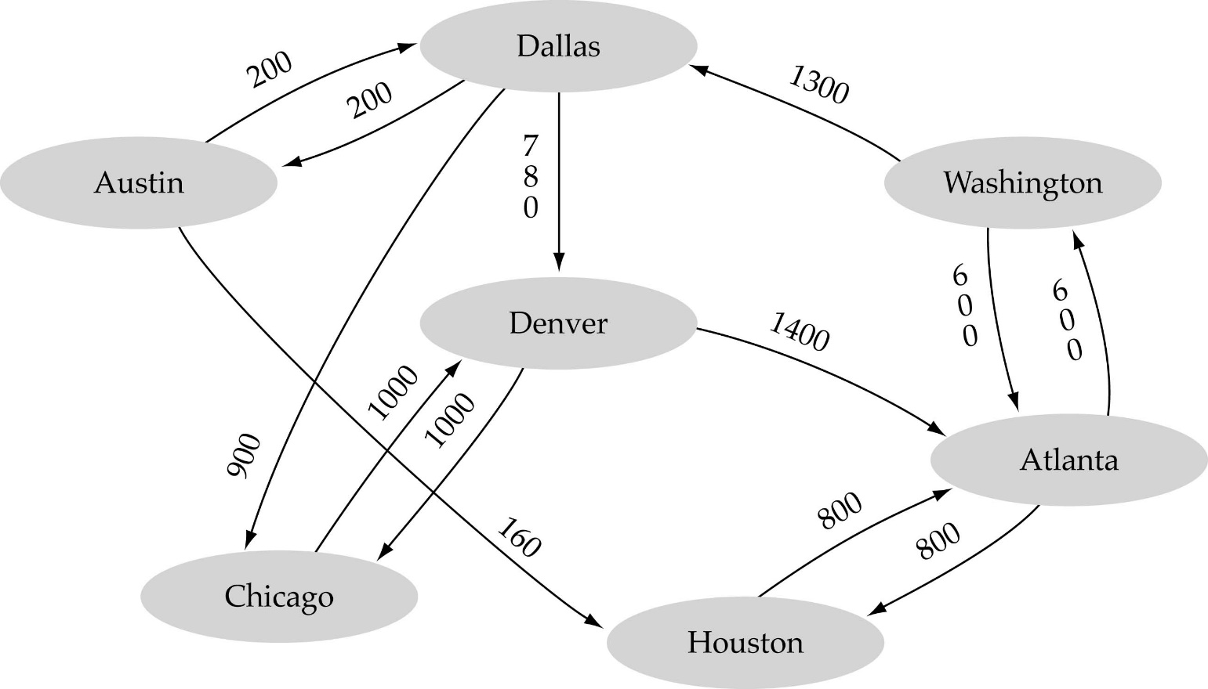
Weighted graph: a graph in which each edge carries a value (weight or cost). The weight may represent distance, driving time, cost of building the highway, etc.

Slide 13

Software Engineering Intern, BS
Chicago, IL, USA
Qualifications: currently pursuing a Bachelor's degree in Computer Science or related technical field.
Excellent implementation skills (C++, Java, Python).
Experience in systems software or algorithms.
More positions https://careers.google.com/jobs#!t=jo&jid=/google/software-engineering-intern-bs-summer-320-n-morgan-st-600-chicago-il-60607-usa-4246980441&

Slide 14
Google - interview invitation
in 2014
As you may already know, referred you for a position as Software Engineer, YouTube Big Data! Your background looks like a potential fit for some software engineering roles we have. As a next step, I'd like to start the process by setting up a Technical/Coding Phone Interview with you and one of our engineers. We will share a Google doc with you so you need to be online with a computer and phone to complete the phone interview. We will evaluate your expertise in the following areas: - Algorithms and Data Structures - Computer Science Fundamentals - Testing Strategy - Software Design Knowledge To get started, please answer the following questions as soon as possible: 1) Please let me know several times/dates in Pacific Time/PT that you’ll be available for 45-minute technical phone interview? 2) What is your GPA for each degree completed and in progress? Please provide transcripts (unofficial is fine). 3) Please let me know when you are free to connect with me for 15 minutes on the phone so I can give you an overview of our interview process. 4) We currently only have open positions in San Bruno and Mountain View, CA - is this okay with you? 5) What are your technical areas of expertise (eg. Distributed systems, Web applications & multi-tiered systems, Advanced Algorithms, Machine learning, etc...)? 6) What are your strongest programming languages (in order of strength, strongest first)?

Slide 15
Graphs as ADTs
Graph operations
Test whether graph is empty.
Get number of vertices in a graph.
Get number of edges in a graph.
See whether edge exists between two given vertices.
Insert vertex in a graph whose vertices have distinct values that differ from new vertex’s value.
Insert edge between two given vertices in a graph.
Remove specified vertex from graph and any edges between the vertex and other vertices.
Remove edge between two vertices in a graph.
Retrieve from graph vertex that contains a given value.

Slide 16
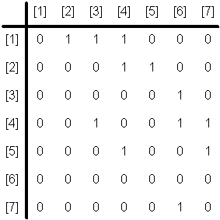
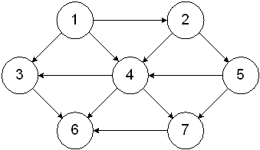
Graph implementation
(1) Array-based implementation
To construct the adjacency matrix:
Number the vertices of the graph 1, 2, ..., n
Construct a matrix that is n x n
For each entry in row i and column j, insert a 1 (or value) if there is an edge from vertex i to vertex j; otherwise insert a 0

Slide 17
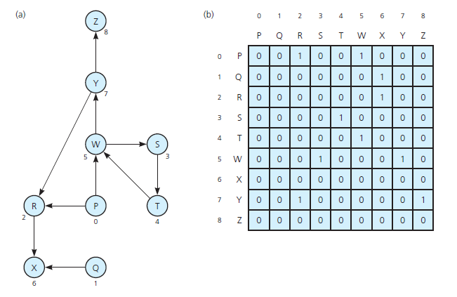
A directed graph (a) and its adjacency matrix (b)

Slide 18
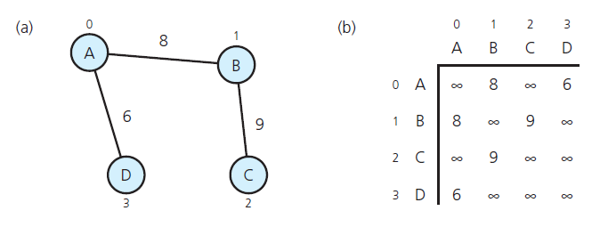
A weighted undirected graph (a) and its adjacency matrix (b)

Slide 19

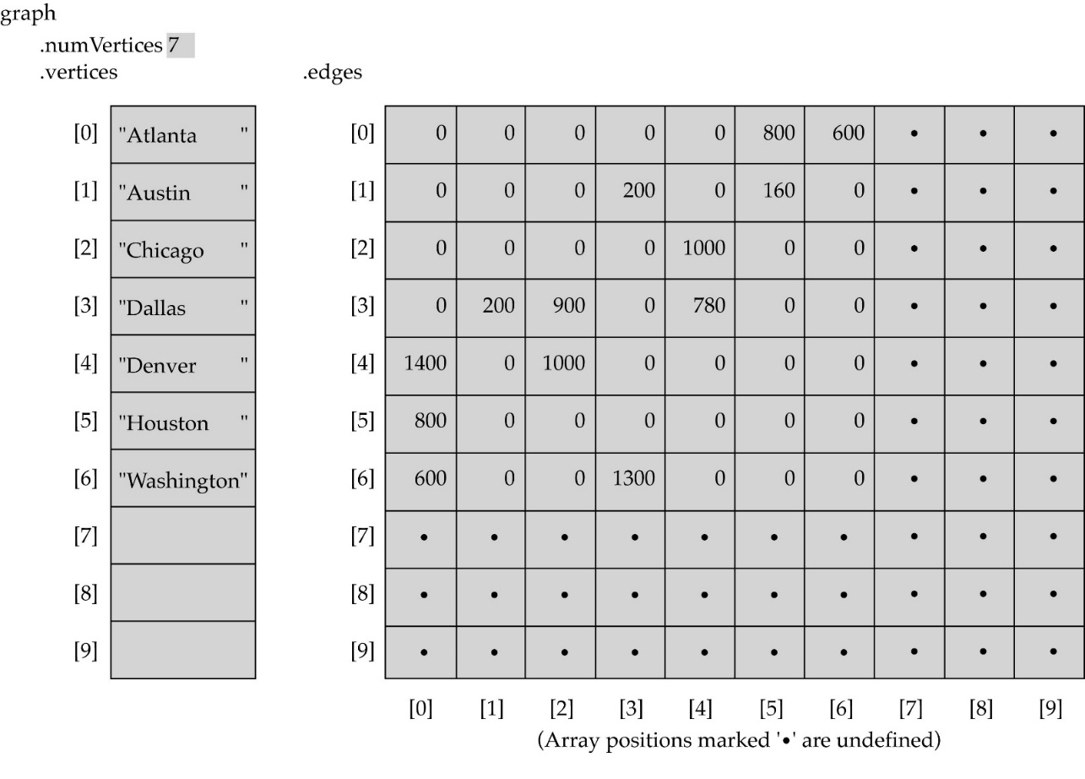
2 arrays are required:
Vertex Array (1D array that holds vertices details)
Adjacency matrix (2D array that hold details of edges)
This representation is suitable for small graphs. One drawback to this type of representation is that it is often sparse, that is, it has a lot of zero entries, and thus considerable space is wasted. (e.g., the 2 billion of Facebook users are not friends to all users)

Slide 20
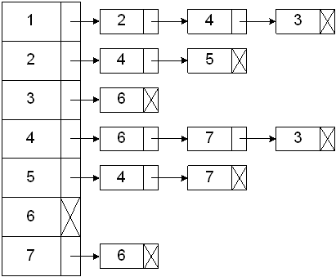
(2) Linked-list implementation
A 1D array is used to hold the data for each vertex in the graph.
For each vertex, there is also a pointer to a linked list of all vertices that are adjacent to the vertex (adjacency list).

Slide 21
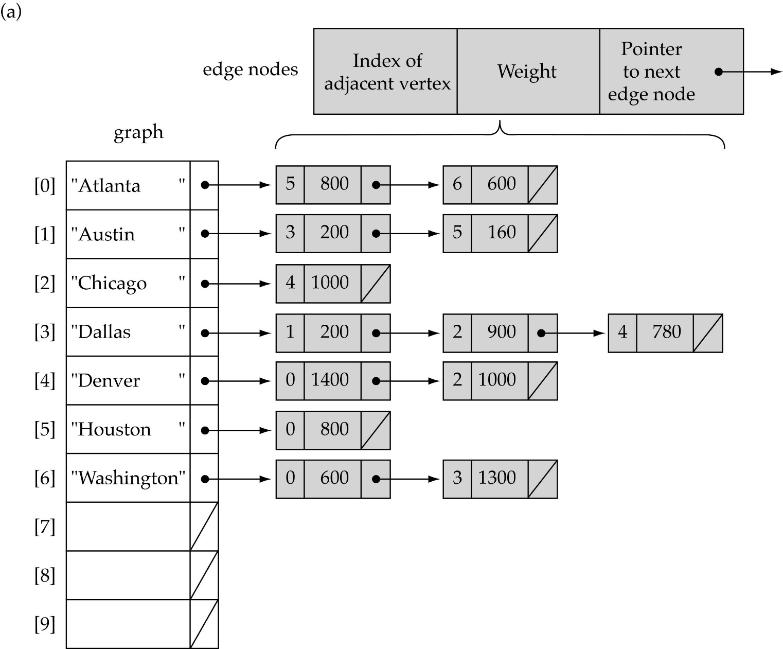
Adjacency list can store vertices and edges

Slide 22
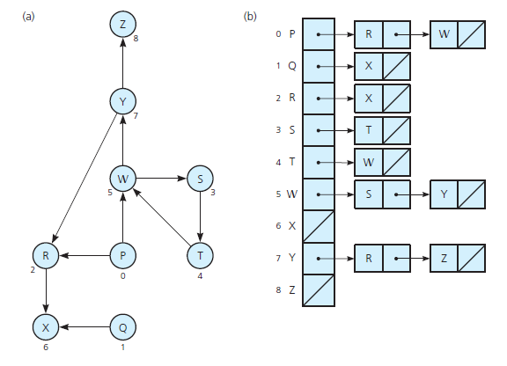
A directed graph (a) and its adjacency list (b)

Slide 23
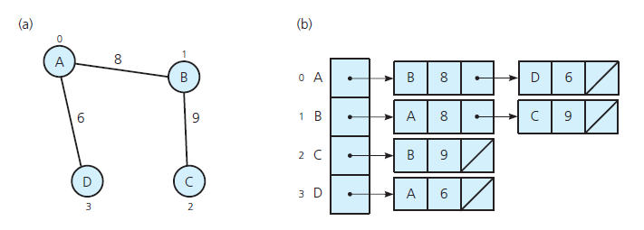
A weighted undirected graph (a) and its adjacency list (b)

Slide 24
Adjacency matrix vs. adjacency list representation
Adjacency matrix
Good for dense graphs --|E|~O(|V|²)
Connectivity between two vertices can be tested quickly
Adjacency list
Good for sparse graphs -- |E|~O(|V|)
Vertices adjacent to another vertex can be found quickly

Slide 25
Graph searching/traversal
Methods: Depth-First-Search (DFS) or Breadth-First-Search (BFS)
Recall that a binary tree has no cycles. Also, starting at the root node, we can traverse the entire tree. On the other hand, a graph might have cycles and we might not be able to traverse the entire graph from a single vertex (for example, if the graph is not connected). Therefore, we must keep track of the vertices that have been visited.

Slide 26
(1) Depth-First-Search (DFS)
DFS is similar to traversing a binary tree preorder traversal with some differences.
What is the idea behind DFS?
Given a starting vertex v
Pick an arbitrary adjacent vertex, visit it.
Travel as far as you can down a path
Back up as little as possible when you reach a "dead end" (i.e., next vertex has been "marked" or there is no next vertex)
Depth-first search is useful for testing a number of properties of graphs, including whether there is a path from one vertex to another and whether or not a graph is connected.
DFS can be implemented efficiently using a stack
https://www.cs.usfca.edu/~galles/visualization/DFS.html

Slide 27
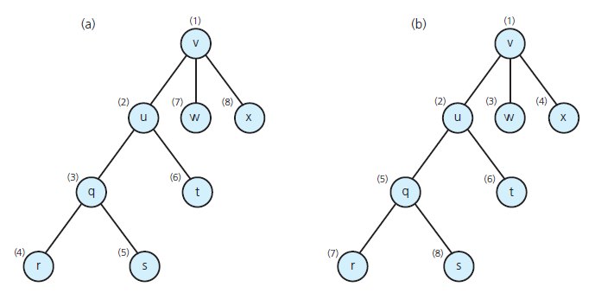
Visitation order for (a) depth-first search; (b) breadth-first search

Slide 28
Depth-First-Search – version 1 - Recursive
Assume all vertices initially unmarked (not visited)
Outer loop to call the depth-first traversal // to visit all vertices
for each vertex, v, in the graph
if v is not visited
DFS(g, v)
DFS(graph g, vertex v)
mark v as visited
for each vertex w adjacent to v
if w is not visited
DFS(g, w)

Slide 29
void depthFirstTraversal() //In C++
{
bool *visited; // pointer to create the array to keep
// track of the visited vertices
visited = new bool[gSize]; //gSize = graph size
for (int index = 0; index < gSize; index++)
visited[index] = false;
// For each vertex that is not visited, do a depth first traversal
for (int index = 0; index < gSize; index++)
if (!visited[index])
DFS(index,visited);
delete [] visited;
} //end depthFirstTraversal

Slide 30
void DFS(int v, bool visited[]) //In C++
{
visited[v] = true;
cout << " " << v << " "; //visit the vertex
linkedListIterator<int> graphIt;
//for each vertex adjacent to v
for (graphIt = graph[v].begin(); graphIt != graph[v].end(); ++graphIt)
{
int w = *graphIt;
if (!visited[w])
DFS(w, visited);
}
}

Slide 31
Depth-First-Search (DFS) – version 2 uses stack
Use non-recursive version if recursion depth is too big (over a few thousands).
DFS(graph g, vertex v)
s = a new empty stack
s.push(v)
Mark v as visited
while(! s.isEmpty())
{
x = s.top() // The vertex on the top of the stack
if (no unvisited vertices are adjacent to x )
s.pop() // Backtrack
else
{
select an unvisited vertex u adjacent to x
s.push(u)
Mark u as visited
}
}

Slide 32
Current vertex: A
A
B
E
G
C
D
F
Start with A. Mark it.

Slide 33
Current: B
A
B
E
G
C
D
F
Expand A’s adjacent vertices. Pick one (B).
Mark it and re-visit.

Slide 34
Current: C
A
B
E
G
C
D
F
Now expand B, and visit its neighbor, C.

Slide 35
Current: F
A
B
E
G
C
D
F
Visit F.
Pick one of its neighbors, E.

Slide 36
Current: E
A
B
E
G
C
D
F
E’s adjacent vertices are A, D and F.
A and F are marked, so pick D.

Slide 37
Current: D
A
B
E
G
C
D
F
Visit D. No new vertices available. Backtrack to
E. Backtrack to F. Backtrack to C. Backtrack to B

Slide 38
Current: G
A
B
E
G
C
D
F
Visit G. No new vertices from here. Backtrack to
B. Backtrack to A. E already marked so no new.

Slide 39
Current:
1
A
2
5
B
E
6
3
7
C
D
G
4
F
Done. We have explored the graph in order:
A B C F E D G

Slide 40
(2) Breadth First Search (BFS)
What is the idea behind BFS?
Visit all vertices adjacent to vertex before going forward
Back up as far as possible when you reach a "dead end" (i.e., next vertex has been "marked" or there is no next vertex)
The breadth first traversal of a graph is similar to traversing a binary tree level by level (the nodes at each level are visited from left to right). All nodes at any level, i, are visited before visiting the nodes at level i + 1.
As in the case of depth first traversal, because it might not be possible to traverse the entire graph from a single vertex, the breadth first traversal also traverses the graph from each vertex that is not visited.
To implement the breadth first search algorithm, we use a queue.

Slide 41
BFS for general graphs
This version assumes vertices have two children
left, right
This is trivial to fix
But still not good for general graphs
It does not handle cycles

Slide 42
Queue: A
A
B
E
G
C
D
F
Start with A. Put in the queue (marked red)

Slide 43
Queue: A B E
A
B
E
G
C
D
F
B and E are next

Slide 44
Queue: A B E C G D F
A
B
E
G
C
D
F
When we go to B, we put G and C in the queue
When we go to E, we put D and F in the queue

Slide 45
Queue: A B E C G D F
A
B
E
G
C
D
F
When we go to B, we put G and C in the queue
When we go to E, we put D and F in the queue

Slide 46
Queue: A B E C G D F F
A
B
E
G
C
D
F
Suppose we now want to expand C.
We put F in the queue again!

Slide 47
Generalizing BFS
Cycles:
We need to save auxiliary information
Each node needs to be marked
Visited: No need to be put on queue
Not visited: Put on queue when found
Need to put all adjacent vertices in queue

Slide 48
BFS(graph g, vertex v)
unmark all vertices in g
For each vertex v in the graph,
If v is not visited
add v to the queue
mark v as visited
while (not empty(q))
remove vertex u from the queue
for each vertex w adjacent to u
if w is not visited
add w to the queue
mark w as visited

Slide 49
The general BFS algorithm
Each vertex can be in one of three states:
Unmarked and not on queue: Not reached yet
Marked and on queue: Known, but adjacent vertices not visited yet (possibly)
Marked and off queue: Known, all adjacent vertices on queue or done with
The algorithm moves vertices between these states

Slide 50
Queue: A
A
B
E
G
C
D
F
Start with A. Mark it.

Slide 51
Queue: A B E
A
B
E
G
C
D
F
Expand A’s adjacent vertices.
Mark them and put them in queue.

Slide 52
Queue: A B E C G
A
B
E
G
C
D
F
Now take B off queue, and queue its neighbors.

Slide 53
Queue: A B E C G D F
A
B
E
G
C
D
F
Do same with E.

Slide 54
Queue: A B E C G D F
A
B
E
G
C
D
F
Visit C.
Its neighbor F is already marked, so not queued.

Slide 55
Queue: A B E C G D F
A
B
E
G
C
D
F
Visit G.

Slide 56
Queue: A B E C G D F
A
B
E
G
C
D
F
Visit D. F, E marked so not queued.

Slide 57
Queue: A B E C G D F
A
B
E
G
C
D
F
Visit F.
E, D, C marked, so not queued again.

Slide 58
Queue: A B E C G D F
A
B
E
G
C
D
F
Done. We have explored the graph in order:
A B E C G D F.

Slide 59
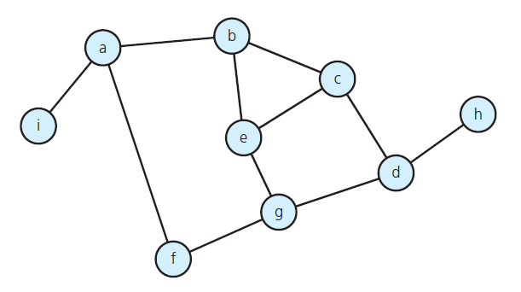
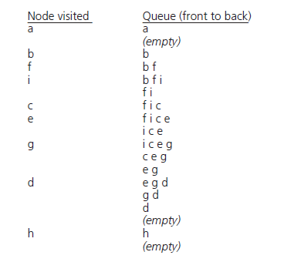
Exercise: show the BFS traversal, beginning at vertex a

Slide 60
Topological Sort
An ordering of vertices in a directed acyclic graph(DAG), such that for every directed edge uv from vertex u to vertex v, u comes before v in the ordering. This is not possible if the graph has a cycle.
Any DAG has at least one topological ordering.
Examples:
Course prerequisites
Scheduling a sequence of jobs or tasks based on their dependencies. The jobs are represented by vertices, and there is an edge from x to y if job x must be completed before job y can be started (for example, when washing clothes, the washing machine must finish before we put the clothes to dry). In this application, a topological ordering is just a valid sequence for the tasks.

Slide 61
Topological Sort
Algorithm:
Find a vertex with no incoming edges
Process it (remove outgoing edges from it) and then remove it from the graph
Repeat

Slide 62
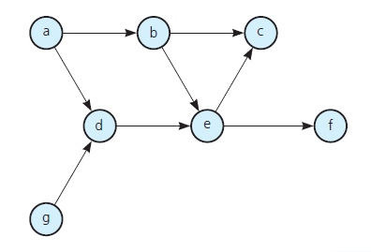
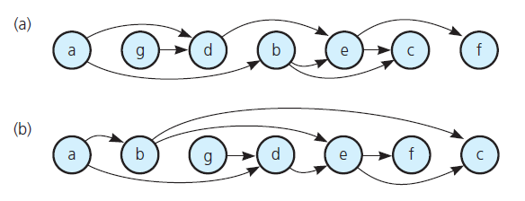
The graph above arranged according to the topological orders
(a) a, g, d, b, e, c, f
(b) a, b, g, d, e, f, c

Slide 63
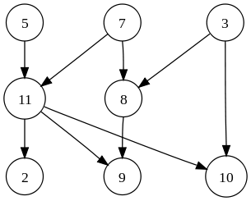
The graph above has many valid topological sorts, including:
5, 7, 3, 11, 8, 2, 9, 10 (visual left-to-right, top-to-bottom)
3, 5, 7, 8, 11, 2, 9, 10 (smallest-numbered available vertex first)
5, 7, 3, 8, 11, 10, 9, 2 (fewest edges first)
7, 5, 11, 3, 10, 8, 9, 2 (largest-numbered available vertex first)
5, 7, 11, 2, 3, 8, 9, 10 (attempting top-to-bottom, left-to-right)
3, 7, 8, 5, 11, 10, 2, 9 (arbitrary)

Slide 64
Topological sorting algorithm – version 1
The indegree of vertex v is the number of edges coming into v. Assuming that the indegree for each vertex is stored and that the graph is stored as an adjacency list, the following algorithm can be derived:
for( counter from 0 through the number of vertices )
v = find a new vertex with indegree of 0
assign a topological number to v using the counter
for each vertex w that is adjacent to v
decrement w's indegree by 1
endfor
endfor

Slide 65
The finding of the vertex with indegree of 0 is accomplished by scanning the vertices looking for a vertex with indegree of 0 and no topological number. If no such vertex exists, then the graph contains a cycle.
Finding the vertex with indegree of 0 has a running time of V. That call is made V times, therefore the algorithm has a running time of V².
The algorithm can be improved by simply storing all of the vertices with indegree of 0 on a queue. The algorithm now has a running time E+V since the for loop is executed at most once per edge, the queue operations are executed at most once per vertex, and the initialization is at most the size of the graph.
The new algorithm resembles:

Slide 66
Topological sorting algorithm – version 2
for each vertex v
if v has indegree of 0
push v onto a queue
Initialize a counter to 0
while the queue is not empty
v = queue.top()
queue.pop()
increment the counter
assign the counter as the topological number for v
for each vertex w that is adjacent to v
decrement w's indegree by 1
if w's indegree is 0
push w onto the queue

Slide 67
Topological sorting algorithm – other versions
Indegree and stack
https://www.cs.usfca.edu/~galles/visualization/TopoSortIndegree.html
Using DFS (when outdegree = 0)
https://www.cs.usfca.edu/~galles/visualization/TopoSortDFS.html

Slide 68
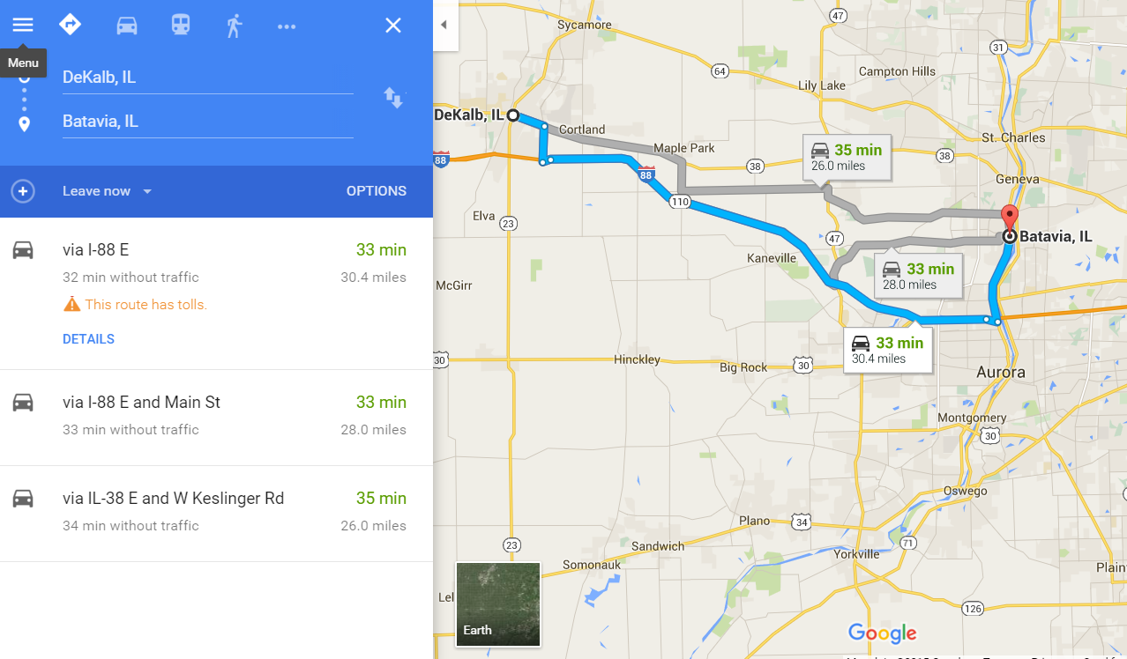
What is the best route from Dekalb to Batavia?

Slide 69

Shortest-path problem
There are multiple paths from a source vertex to a destination vertex
Shortest path: the path whose total weight (i.e., sum of edge weights) is minimum.
Dijkstra’s Algorithm finds the shortest path from a given node to all other reachable nodes in a weighted graph with nonnegative edge weights.
Examples:
Austin->Houston->Atlanta->Washington: 1560 miles
Austin->Dallas->Denver->Atlanta->Washington: 2980 miles

Slide 70
Dijkstra’s algorithm
Dijkstra’s algorithm builds up a tree.
It is a greedy algorithm that solves problems in stages by doing what appears to be best at each stage.
For example, in the following graph, we want to find shortest paths from node B
3
A
A
3
1
5
0
4
6
5
2
B
C
D
B
C
D
4
5
8
9
1
E
F
E
F
Edge values in the graph are weights
Node values in the tree are total weights

Slide 71


Edsger W. Dijkstra
“If debugging is the process of removing software bugs, then programming must be the process of putting them in”
“Program testing can be used to show the presence of bugs, but never to show their absence!”
- “Simplicity is prerequisite for reliability”
Received the 1972 A. M. Turing Award, widely considered the most prestigious award in computer science.
Made a strong case against use of the GOTO statement in programming languages and helped lead to its deprecation.
Known for his many essays on programming.

Slide 72
Dijkstra’s shortest-path algorithm
The graph needs to be initialized with high values at the beginning.
The algorithm stores all weights from the source vertex to all other vertices in the graph in an array called weight.
It then step by step attempts to visit the vertex with minimum weight using the vertices stored in a set visited, and adding the newly visited vertex to it.

Slide 73
Dijkstra’s shortest-path algorithm
shortestPath(in theGraph, in weight:WeightArray) {
// Finds the minimum-cost paths between an origin vertex (vertex 0) and all other
// vertices in a weighted directed graph.
visited = vertex 0
n = number of vertices in the Graph;
// Step 1
for (x=0 through n-1)
weight[v] = matrix[v][x];
// Steps 2 through n
for (step=2 through n) {
Find the smallest weight[v] such that v is not visited
Add v to visited;
for (each neighbor u of v not in visited)
if (weight[u] > weight[v]+matrix[v][u])
weigth[u] = weight[v]+matrix[v][u];
}}

Slide 74
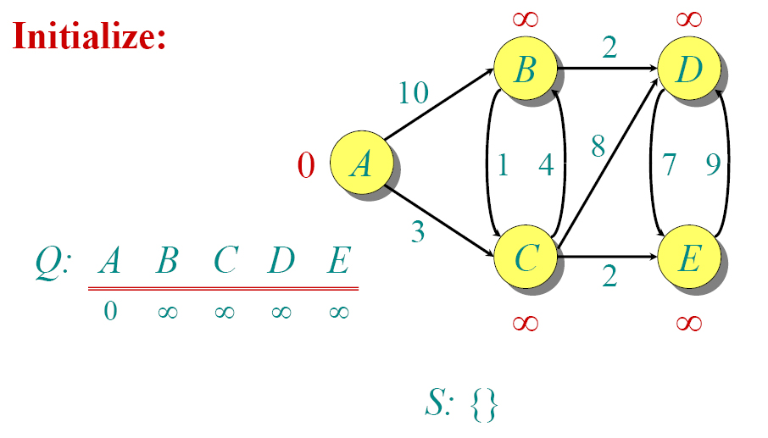
Dijkstra Animated Example
Weight
Visited

Slide 75
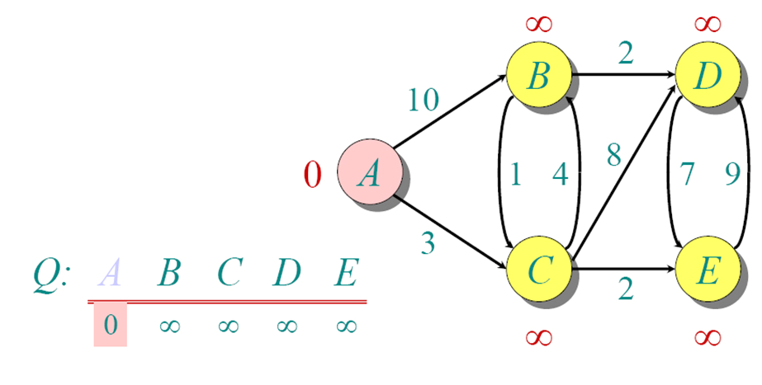
Dijkstra Animated Example

Slide 76
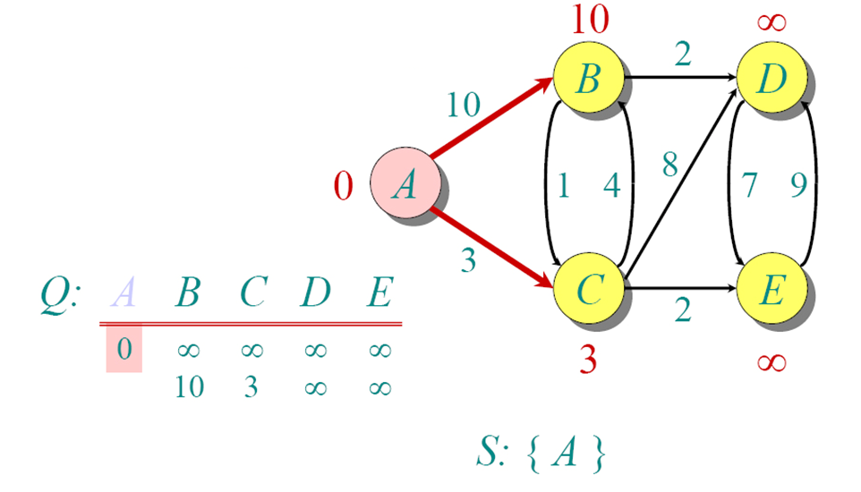
Dijkstra Animated Example

Slide 77
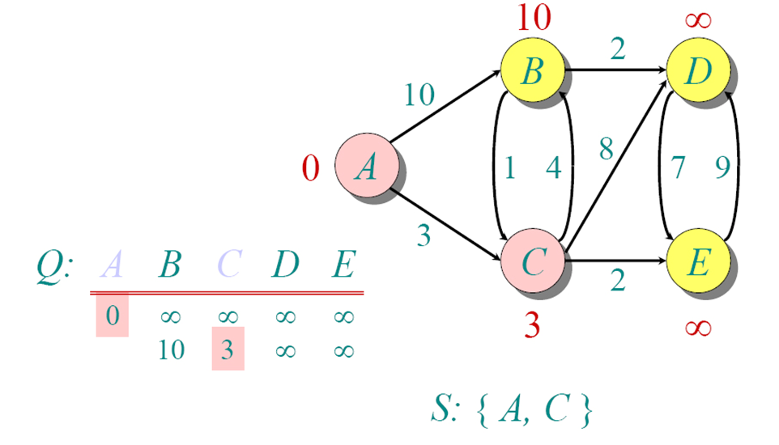
Dijkstra Animated Example

Slide 78
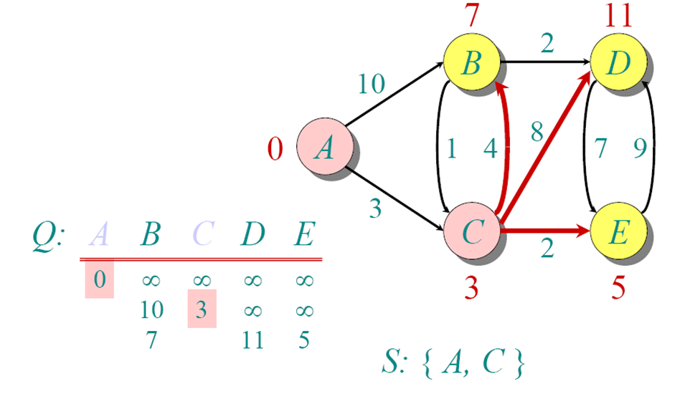
Dijkstra Animated Example

Slide 79
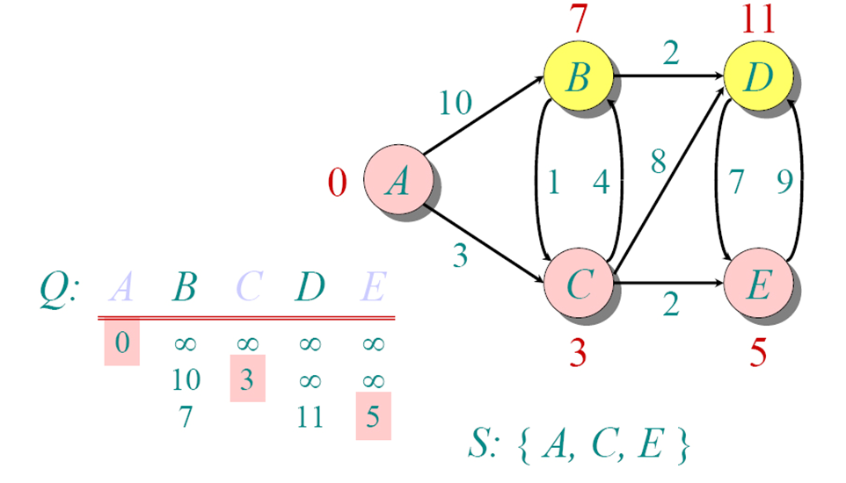
Dijkstra Animated Example

Slide 80
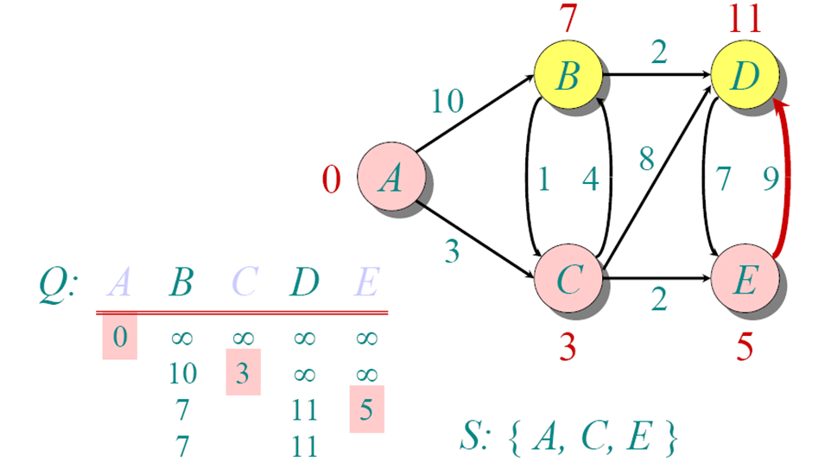
Dijkstra Animated Example

Slide 81
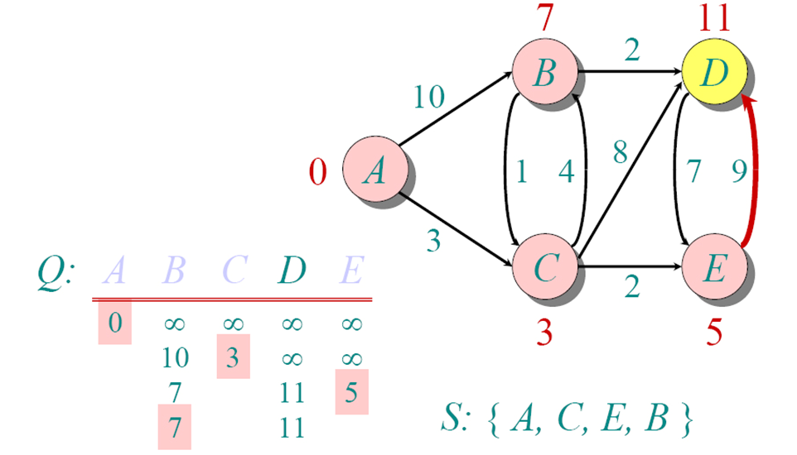
Dijkstra Animated Example

Slide 82
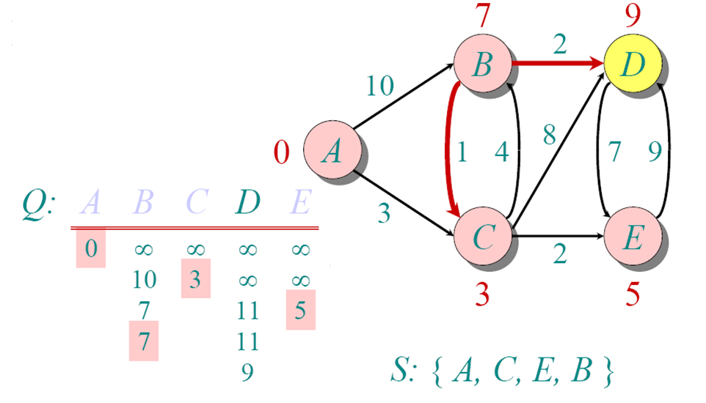
Dijkstra Animated Example

Slide 83
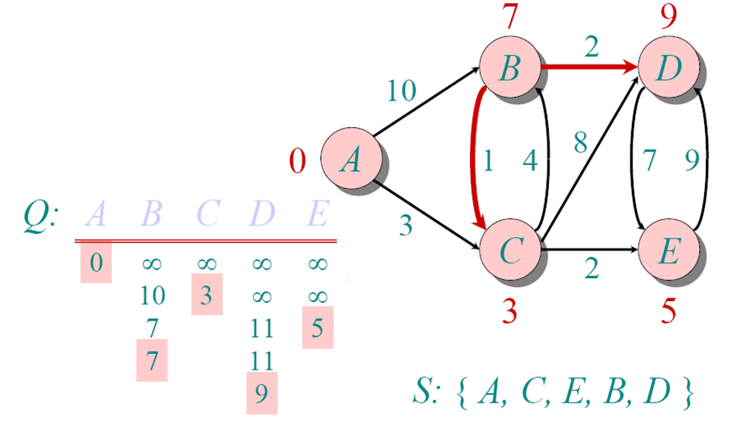
Dijkstra Animated Example

Slide 84
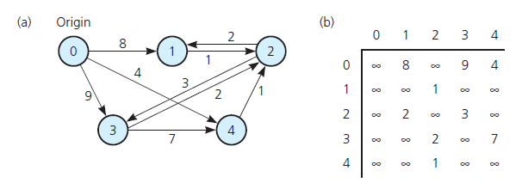
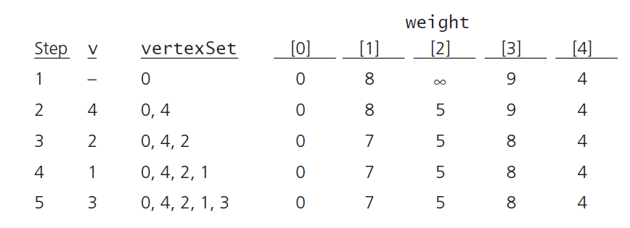
Find the shortest path from 0 to all other vertices
Visited

Slide 85
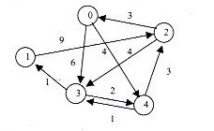
Find the shortest path from 0 to all other vertices
 | 0 | 1 | 2 | 3 | 4
0 | ∞ | ∞ | ∞ | 6 | 4
1 | ∞ | ∞ | 9 | ∞ | ∞
2 | 3 | ∞ | ∞ | 4 | ∞
3 | ∞ | 1 | ∞ | ∞ | 2
4 | ∞ | ∞ | 3 | 1 | ∞
weights
Count | Vertex | Visited | 0 | 1 | 2 | 3 | 4
1 | _ | 0 | 0 | ∞ | ∞ | 6 | 4
2 | 4 | 0,4 | 0 | ∞ | 7 | 5 | 4
3 | 3 | 0,4,3 | 0 | 6 | 7 | 5 | 4
4 | 1 | 0,4,3,1 | 0 | 6 | 7 | 5 | 4
5 | 2 | 0,4,3,1,2 | 0 | 6 | 7 | 5 | 4

Slide 86
What if unweighted?
All distances are 1.
Equivalent to breath-first search
Look for all vertices that are distance 1 away from the start (or currently dequeued element), put in a queue, repeat until all nodes are marked.

Slide 87


Slide 88
Acknowledgments
Data Abstraction & Problem Solving with C++, Carrano, 6th, 2012, Chapter 20
Data Structures Using C++, 2nd Edition, Malik, 2009, Chapter 12
Data Structures and Algorithms in C++ (2rd ed.), Michael T. Goodrich, Roberto Tamassia, David M. Mount, 2011, Chapter 13.
Data Structures and Algorithms in C++ (4rd ed.), Adam Drozdek, 2005. Chapter 8
Data Structures with C++ Using STL 2nd, Ford, 2001, Chapter 16
Data Structures and Algorithm Analysis in C++, Mark Allen Weiss, 4th ed, 2013, Chapter 9
Notes of George Bebis, Hsin-His, Gal A. Kaminka, David Matuszek, Jonathan Davis, and Laksman Veeravagu and Luis Barrera
http://mathworld.wolfram.com/
Dijkstra's Algorithm animation
http://optlab-server.sce.carleton.ca/POAnimations2007/DijkstrasAlgo.html

